Slide 1
Automating Change
Evolution of Deployment in an On-Demand World
John Gildenzoph, Devops Engineer total administrative services corporation
Notes:
Hello, I want to start by saying that I am honored to be here amongst the names and companies that are in attendance at the conference. It is definitely a humbling experience, but I am truly excited to have this opportunity to share some of the work that we are doing at TASC.

Slide 2
About Me
13 years in the technology space
Started out as a programmer developing engineering based tools for a large electric motor and generator manufacturer.
Experience in the areas of Software Development, Quality Assurance, Systems Administration, Database Administration, Network Administration, Project Management, Process Management
In 2011 hired on at TASC as a Java Developer
Currently hold the title of DevOps Engineer working in the Enterprise Architecture Department at TASC
Notes:
So just a little bit about my background. I have been in the technology space professionally for about 13 years. I have an electrical engineering background however I quickly realized the programming was where I felt most at home and actually started as a programmer developing engineering based tools for a large electric motor and generator manufacturer.
In my tenure at that company I basically never said no. Where some people might move from position to position, I acquired positions. While a bulk of my experience is/was in software development I became the a Linux administrator and also was intimately involved in Database Administration and Network Administration. I was always a big picture guy and liked to know how, at least on some level, it all worked and how it all tied together. I also really enjoyed figuring out how to make it operate more smoothly.
I am sure many of you in this room found similar paths. Back then we didn’t have a term for that, today we call that space DevOps.
I was hired in May 2011 by TASC as a Java Developer. It was quickly apparent I think to my colleagues and boss that was not really where I belonged. I chuckle because I think I have literally opened Eclipse about 5 times in my tenure to date at TASC. I almost immediately started on various oddball projects centered around ways to make our development group more efficient and stand up tools to better help some of our core goals
Recently TASC finally found me a home in the Enterprise Architecture Department and basically created a new title for me as a DevOps Engineer.

Slide 3

About TASC
Total Administrative Services Corporation (TASC)
Based in Madison, WI with offices in Minneapolis.
Industry Leader as the nation's largest privately-held TPA
Nationwide administrator of tax-advantaged health benefit plans offering comprehensive services for Clients, Participants, and Providers and serving companies ranging in size from 1 employee to thousands of employees
8,000 field representatives and over 900 associates at the Madison campus and remote locations.
Our Technology department current sitting around 100 employees stateside and off shore.
Web-Based Application and Mobile App serving an average 40k per day and more than 85k during peak usage
Notes:
So who is TASC? TASC is an acronym for Total Administrative Services Corporation. Quite the mouthful, hence the acronym. We are based out of Madison Wisconsin with another main office in Minneapolis. We are the nation’s largest privately held third party benefits administrator. We provide comprehensive services for companies ranging from 1 employee to thousands.
We have customers in all 50 states that are served by the TASC team, which boasts 8,000 field representatives and over 900 associates at the Madison campus and remote locations.
Our technology team is made up of about 100 employees both stateside and off shore. This includes Developers, QA, Infrastructure and Enterprise Architecture.
We pride ourselves on being the most technology savvy company in our industry. We have a Mobile Application used by our customers to submit claims and manage their information and Our core web application serves not only our customers but also is how our internal employees operate and manage services for our customers.

Slide 4
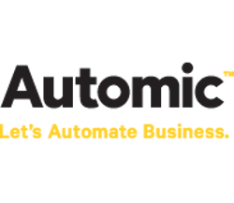

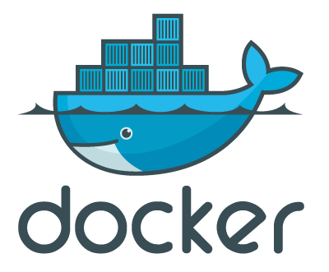


Overview
The TASC Story
Continuous Delivery: The Holy Grail
Improve Cycles
Development
Testing
Delivery
Deployment
Road to Improvement
Efficacy
Efficiency
Consistency
Notes:
So what I want to talk about with you today is the TASC story and how we initiated change throughout our technology department to accomplish a more agile and productive environment.
The TASC odyssey started with a simple problem: How do we improve our development, delivery, testing and deployment cycles? As a relatively small development group we began to feel the pain of the inefficiencies in these cycles and knew if we ever wanted to push forward towards the holy grail of a continuous delivery lifecycle we would need to start taking steps to remedy that problem.
So we knew that there were issues with our development, testing, delivery and deployment cycles, and we knew what was going to improve those was three basic concepts: efficacy, efficiency and consistency.

Slide 5
What is our first step?
Notes:
So now that we identified the problem and we knew the core concepts we needed to focus on. In order to attack those core competencies on all fronts, our first step really boiled down to one thing for us.
That was …

Slide 6
Automation
Riding the road to improvement
Efficacy: the ability to produce a desired or intended result.
Efficiency: achieving maximum productivity with minimum wasted effort or expense.
Consistency: unchanging in achievement or effect over a period of time.
Drive process change through the organization
Get buy in from developers, QA, PM, BA, and the Business
Notes:
Automation. We knew if we were ever to achieve what we wanted to achieve when it came to continuous delivery, we would first have to have well established and well documented processes. Both of these requirements were easily met by automating some parts if not all parts of our development, testing and deployment cycles.
Automation was an obvious plan of attack for us meeting the core concepts we wanted to improve and ride that road to improvement. Beginning with Efficacy. Efficacy is often just taken for granted and not mentioned to often when talking about this topic, but efficacy is the ability to produce a desired or intended result. So we can all agree a very important piece of the puzzle if you cannot produce the desired result you won’t be successful.
Next up is efficiency, which a lot of time is the area we as companies spend the most amount of time on improving. It is the ability to achieve maximum productivity with minimum wasted effort or expense. Definitely was the area that we most needed improvement in, and also definitely something automation would help with.
The final concept is consistency. Is your process repeatable, and not just repeatable but repeatable and unchanging. Consistency will both improve your efficiency and efficacy, and as we learned very early on in this process, automation really helps you drive consistency.
Focusing on automation as the solution gave us two big positives. First it was very great way of driving process change through the organization. By taking the time to examine the current process and really asking the hard questions of why we were doing certain things actually brought a lot of things to light and in the process of automating we actually improved the core processes. The second positive for us was that it was very easy to get buy in from the consumers, automation brought with it a much simpler way of performing complex tasks. This made most people’s day to day work less complex and since the execution of processes became easier, we were able to put the power of those processes in the hands of users that didn’t have access to them before.

Slide 7
In The Beginning …
Production
MYSQL
F5
JBoss (Web)
Operations
JBoss (Web)
JBoss (Web)
JBoss (Web)
JBoss (Proc)
JBoss (Web)
JBoss (Proc)
Quality Assurance
JBoss (Web)
Model Office (Staging)
MYSQL
F5
JBoss (Web)
JBoss (Web)
JBoss (Web)
JBoss (Proc)
QA1
JBoss
MySQL
Subversion
QA2
Developers
JBoss
MySQL
Notes:
In the beginning, when I first arrived at TASC this is pretty much how the core application development and deployment cycle was. Developers used subversion for source code management and developed locally on their respective workstations.
Our testing and production environments were all on our VM farm. We had about 5 lower QA environments that were utilized for QA Testing, UAT Testing, Demoing, and even used as sandboxes for developers. Model Office was used as our staging environment again used for QA Testing, Regression type testing before production.
…

Slide 8
Issues
Slow development cycle with no transparency
Archaic and manual testing with slow turnaround
Manual, inconsistent, time consuming deployments
Lack of knowledge about our deployment process
Monolithic, static, inconsistent infrastructure

Slide 9
First Steps Toward Automation
Finding tools to empower us to automate

Slide 10
First Steps Toward Automation
Introduction of Jenkins
Build Monitoring and Testing
Lower Environment Deployment
Introduction of Automic Automation Engine
Production Environment Deployment
Universal gap filler
Future Automation Platform

Slide 11
First Steps Towards Automation
Production
MYSQL
Automic Automation Engine
F5
JBoss (Web)
Operations
JBoss (Web)
JBoss (Web)
JBoss (Web)
JBoss (Proc)
JBoss (Web)
JBoss (Proc)
Quality Assurance
JBoss (Web)
Model Office (Staging)
MYSQL
F5
JBoss (Web)
JBoss (Web)
JBoss (Web)
JBoss (Proc)
Jenkins
QA1
JBoss
MySQL
Subversion
QA2
Developers
JBoss
MySQL
Notes:
Introduction of Jenkins
Build Monitoring and Testing
First taste of simplified automated deployments to lower environments and easily exposed that to non-operations users
Introduction of Automic Automation Engine
Deployment to production environments which required more sophisticated workflow
We knew AE was the future for our automation but was not quite where we needed it to be for lower environment deployments

Slide 12
What Improved
Detected Development Issues Early
Increased Testing and Analysis
Rapid Deployment to Lower Environments
Complete Buy In
Simplified the complex production workflow
Added safety nets and health checks
Allowed to tackle tasks in parallel
Drastically reduced deployment times ( < 1 hour )

Slide 13
Expanding Automation
Extending and enhancing automation tools

Slide 14
Goals
Modularization of code
Dependency Management
Separating development and deployment cycles
Unified deployment process for all levels of environments
Deployment down time reduction and/or elimination

Slide 15
Expanding Automation
Introduction of Sonatype Nexus Maven Repository
Dependency Management
Artifact Repository
Introduction of Automic Application Release Automation
Web Interface specifically for Software Deployment
Harnessing power of Automic Automation Engine

Slide 16
Expanding Automation
Production
MYSQL
Automic Automation Engine
F5
JBoss (Web)
Operations
JBoss (Web)
JBoss (Web)
JBoss (Web)
JBoss (Proc)
JBoss (Web)
JBoss (Proc)
Quality Assurance
Automic Application Release Automation
JBoss (Web)
Model Office (Staging)
Project Managers
MYSQL
F5
JBoss (Web)
Business Analyst
JBoss (Web)
JBoss (Web)
Business User
JBoss (Proc)
Jenkins
Sonatype Nexus
QA1
JBoss
MySQL
Subversion
QA2
Developers
JBoss
MySQL
Notes:
Introduction of Automic Application Release Automation
Not only abstracted our existing production deployment but also made the interfacing and execution of that deployment process simple enough for non-operations users
Introduction of Sonatype Nexus Maven Repository
Conversion to Maven drastically help how we packaged and delivered artifacts and simplified the deployment of those artifacts.

Slide 17
What Improved
Provided much more stable development process
Allowed us to start breaking up pieces of our code
Provided separation between our development and deployment cycles
Provided access to all deployment artifacts
Compliance, Compliance, Compliance
Abstracted our existing production deployment process
Web based tool brought ease of use for non-operations users
Easy workflow monitoring and troubleshooting
Deployments with downtime reduced to 24 minutes
Rolling Deployments with 0 down time

Slide 18
What’s Next?

Slide 19
Automation of Infrastructure
Infrastructure as a service

Slide 20
Goals
More dynamic testing environment
Empower quality assurance group
Eliminate resource constraints
Resource savings
Cost savings
Transparency

Slide 21
Automation of Infrastructure
Leveraging Automic AE and ARA for provisioning of infrastructure
Merge the orchestration of infrastructure, middleware and software deployment
Introduction of AWS and Amazon EC2
No resource limitation
Pay for what you use model

Slide 22
To the Cloud
Production
MYSQL
Automic Automation Engine
F5
JBoss (Web)
Operations
JBoss (Web)
JBoss (Web)
JBoss (Web)
JBoss (Proc)
JBoss (Web)
JBoss (Proc)
Quality Assurance
Automic Application Release Automation
JBoss (Web)
Model Office (Staging)
Project Managers
MYSQL
F5
JBoss (Web)
Business Analyst
JBoss (Web)
JBoss (Proc)
JBoss (Web)
Business User
Amazon EC2
TEST-ENV-1
Jenkins
Sonatype Nexus
JBoss
MySQL
TEST-ENV-2
PHP
MySQL
TEST-ENV-3
Forgerock
JBoss
PHP
MySQL
Subversion
Developers
TEST-ENV-4
…

Slide 23
Infrastructure On-Demand
Amazon EC2 AMI
Automic Automation Engine
Operations
JBoss
Forgerock
Solr
MySQL
PHP
.NET
Quality Assurance
Automic Application Release Automation
Project Managers
Amazon EC2
Business Analyst
Business User
TEST-ENV-1
JUMP
JBoss
MySQL
TEST-ENV-2
Developers
PHP
MySQL
TEST-ENV-3
Forgerock
JBoss
PHP
MySQL
TEST-ENV-4
…

Slide 24
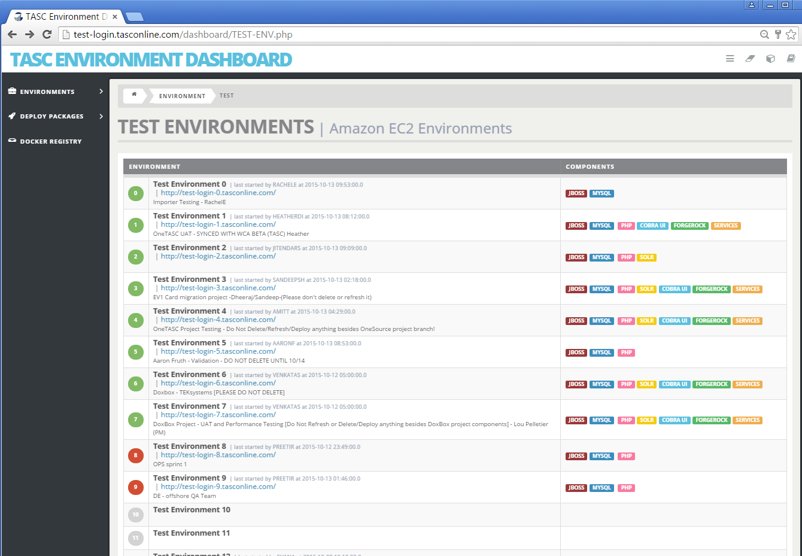
Environment Transparency

Slide 25
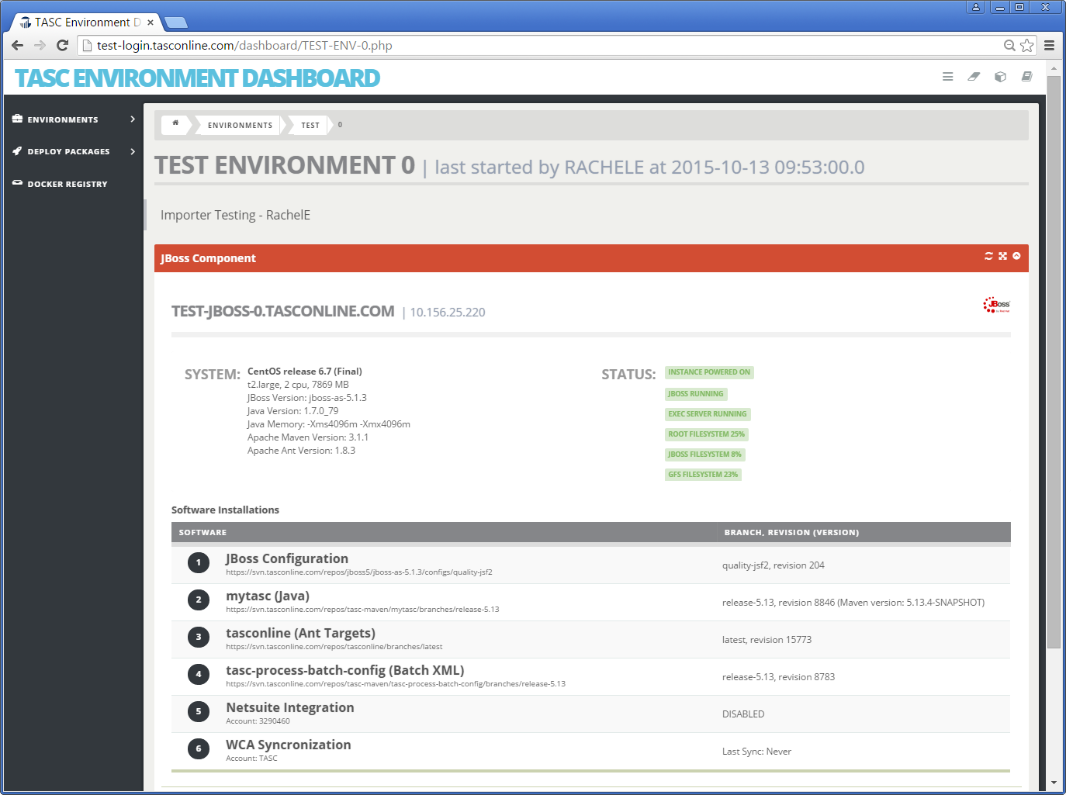
Environment Detail

Slide 26
What Improved
On demand multipurpose environments
On demand component refresh in record time
Endless capacity
Cost Savings: pay for what you use
Self-Service
Repeatability drove stability
Improved QA turn around
Improved environment management and transparency
Server patching and middleware configuration updates

Slide 27
Applying to Staging Level
Amazon EC2 AMI
Automic Automation Engine
Operations
JBoss
Forgerock
Solr
MySQL
PHP
.NET
Quality Assurance
Automic Application Release Automation
Project Managers
Amazon EC2
Business Analyst
STAGING-ENV-1
JBoss (Proc)
MYSQL
Business User
F5
JBoss (Web)
JUMP
JBoss (Web)
JBoss (Web)
Developers
PHP
PHP
STAGING-ENV-2
MYSQL
F5
JBoss (Web)
JBoss (Web)
…

Slide 28
Production and Amazon EC2
Currently in progress at TASC
Reimagining Traditional Deployment
AMI becomes the deployment artifact
Deploying system patches, middleware configuration, software
Increase stability through turnover
Notes:
Deploying Infrastructure and Software together

Slide 29
So … What’s Next?

Slide 30
Micro Service
Development
Deployment
Java Service Development
Docker Container Development
GIT Repository (Source Code)
Jenkins (Build Code and Container)
Docker Registry (Artifact Repository)
Automic ARA (Orchestrator)
Spring Cloud Config (Configuration)
AWS ECS (Autoscale Host/Container)
Nginx/Consul/Registrator (Service Discovery)
Elasticsearch/Logstash/Kibana (Log Management)

Slide 31
Does this look familiar?
Docker Registry
Automic Automation Engine
Operations
Container
Container
Container
Container
Container
Container
Quality Assurance
Automic Application Release Automation
Project Managers
Amazon EC2 Container Service
Business Analyst
CLUSTER 1
JUMP
Business User
EC2 INSTANCE
Developers
EC2 INSTANCE
…
Spring Cloud Config
CLUSTER 2
EC2 INSTANCE
…

Slide 32
Top Five Takeaways
Your automation tool is an orchestrator not a worker
Seek out the right tool for the job
Never stop improving your process
Use automation as a way to change process
Take time to focus on what you are doing right

Slide 33
Here’s what I’m looking for help with
Configuration Management
Sizing/Scaling EC2 Instance and Sizing/Scaling Docker Containers
Dependency management and grouping strategy for docker containers
Production level diagnostic tools for management of docker containers

Slide 34
Q & A

